Slide 1

Unmasking the Unusual: A Guide to Outlier Detection Methods
Discovering the techniques that identify unusual patterns in data
Submitted to:-Dr. Anirudha Gaikwad Assistant Professor(Dept of CSE)

Slide 2


The Silent Signals: Why Outlier Detection Matters
What Are Outliers?
Data points that deviate significantly from the expected patterns and normal behavior in a dataset
Why It's Critical
Fraud detection, cybersecurity threats, healthcare monitoring, and financial analytics all rely on identifying unusual patterns
The Goal
Spot these unusual instances early to mitigate risks, prevent fraud, and improve decision-making

Slide 3
Understanding the Landscape: A Spectrum of Approaches
Different methods excel in different scenarios. Here's a comprehensive overview of outlier detection techniques:
1 2
3
Statistical Methods
Use distributional assumptions like Z- score and modified Z-score to identify deviations
Distance-Based Methods
Flag points far from neighbors using techniques like k-nearest neighbors (kNN)
Density-Based Methods
Identify points in low-density regions, such as Local Outlier Factor (LOF)
4
5
Model-Based Methods
Learn normal patterns using Isolation Forest, One-Class SVM, and autoencoders
Histogram-Based Methods
Efficient detection using histograms like HBOS and extended HBOS (EHBOS)

Slide 4





Local Outlier Factor (LOF): Density Deviation Detective
Core Idea
A point is flagged as an outlier when its local density is substantially lower than its neighboring points
How It Works
Computes local density deviation by comparing a point's density to its k-nearest neighbors in the feature space
Visualizing LOF
Points with significantly lower density than their neighbors are flagged as anomalies
Use Case
Particularly effective for detecting anomalies in datasets with varying density regions

Slide 5

Isolation Forest: The Speedy Isolator
Core Idea
Anomalies are "few and different," making them easier to isolate than normal points
How It Works
Builds an ensemble of isolation trees by randomly partitioning data.
Anomalies have shorter average path lengths
Advantage
Computationally efficient with low memory demand, handles high- dimensional data effectively
Key Parameter: contamination controls the proportion of outliers expected in the dataset

Slide 6
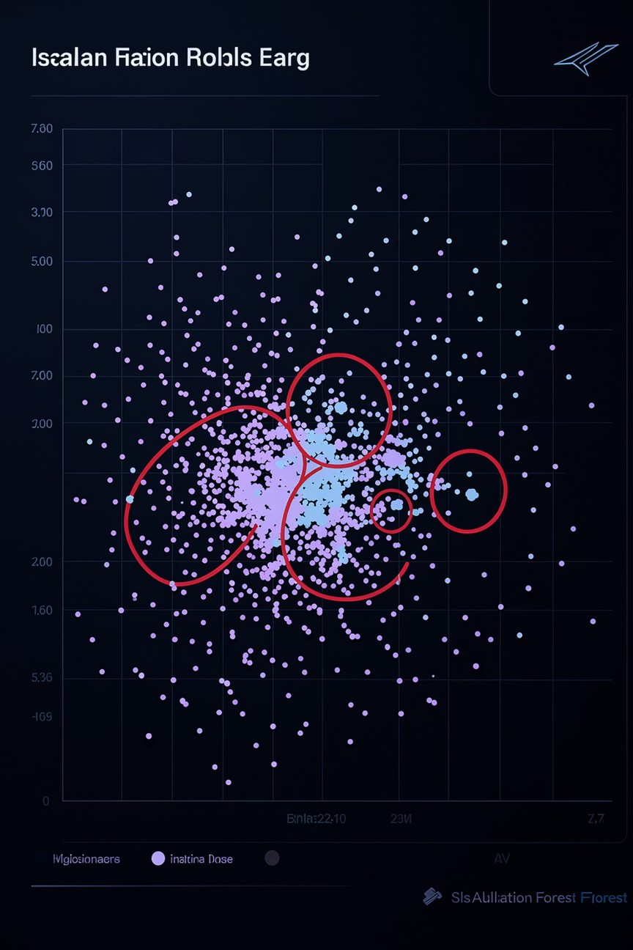

Finding the Odd Ones Out
The Isolation Forest identifies anomalies by measuring how quickly a point can be isolated through random partitioning. Points that require fewer splits to isolate are flagged as outliers.

Slide 7

Histogram-Based Outlier Score (HBOS): Efficiency Meets Insight
Original HBOS Computationally efficient method using univariate histograms per feature. However, assumes feature independence, limiting
detection of multivariate anomalies
Extended HBOS (EHBOS)
Incorporates 2D histograms to capture feature pair dependencies, improving detection of contextual anomalies that span multiple dimensions
Benefit: EHBOS outperforms standard HBOS on datasets where feature interactions are critical for anomaly detection

Slide 8

One-Class SVM: Defining the "Normal" Boundary
Core Idea
Learns a tight boundary that encompasses the "normal" data distribution, treating everything outside as an anomaly
How It Works
Estimates the support of a high-dimensional distribution, classifying points outside this learned support region as outliers
Parameters
Kernel type (e.g., 'rbf', 'linear'), nu parameter controls upper bound on training errors and lower bound on support vectors
Use Case
Effective when the majority of data represents normal behavior and outliers are rare occurrences

Slide 9




Real-World Impact: Where Outliers Tell the Story
Fraud Detection
Identifying suspicious transactions that deviate from typical spending patterns and user behavior
Cybersecurity
Detecting unusual network traffic patterns, unauthorized access attempts, and potential security breaches
Healthcare
Spotting abnormal patient vital signs, disease outbreaks, and unusual treatment responses
Manufacturing
Pinpointing defective products, equipment malfunctions, and quality deviations on production lines

Slide 10





The Future of Anomaly Detection: Smarter, Faster, More Contextual
Deep Learning Advancements
Neural networks and autoencoders for detecting complex, multi-dimensional anomaly patterns
Real-Time Detection
Streaming algorithms that identify outliers instantly as data arrives in real-time
Enhanced Interpretability
Understanding why a point is flagged as an outlier through explainable AI techniques
Robust Algorithms
Continued development of efficient, scalable methods like EHBOS for large datasets

Slide 11
THANK YOU

